Slide 1
Factors affecting the Spread of Disease
Edited by E. Rayner 2022

Slide 2
Check Vocabulary
Endemic disease – Relatively constant rate in a population. The disease is always present
Outbreak – A sudden, unexpected increase in the prevalence of a particular disease above the baseline level for that population; it could be a single case of a contagious disease in a small community
Epidemic – An increase in the occurrence of a specific disease above the baseline level for a particular population; it tends to refer to larger, more serious events than an outbreak
Pandemic – A disease that has spread rapidly throughout the world; an epidemic that has crossed international borders
Spread – To transmit a pathogen to a susceptible host over a wider area & into new populations

Slide 3
Interrelated factors
The rate of spread of a specific disease is affected by a range of interrelated factors, including growth of the pathogen population, density of the host population and modes of transmission.
Growth of pathogen population
Mode of transmission
Density of host population
Interrelated factors are those that depend on and have an effect on one another.
All play a vital part in spread. They need to occur together for spread to be possible.

Slide 4
Pathogen characteristics
Pathogen
Growth
Infectivity
Virulence
Mode of Transmission
Dormant Stage, Asymptomatic, Incubation Period
Infectious Dose
Evolution

Slide 5
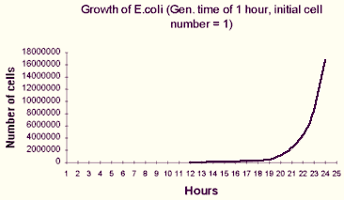
Pathogen
Growth of the pathogen population
  Simple life cycles allow for exponential growth. E.g. Binary fission
  Many generations allow for evolution through mutations and changing environments.

Slide 6
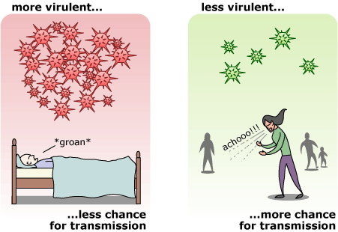
Pathogen
  Virulence – the ability of a pathogen to cause severe disease within its host

Slide 7
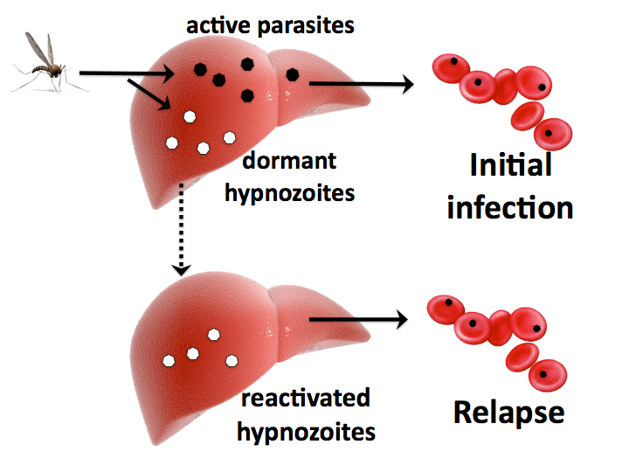
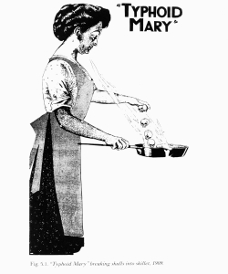
Pathogen Life cycle
Dormant stage.
Spread with no symptoms. (Carrier)
Incubation period.

Slide 8
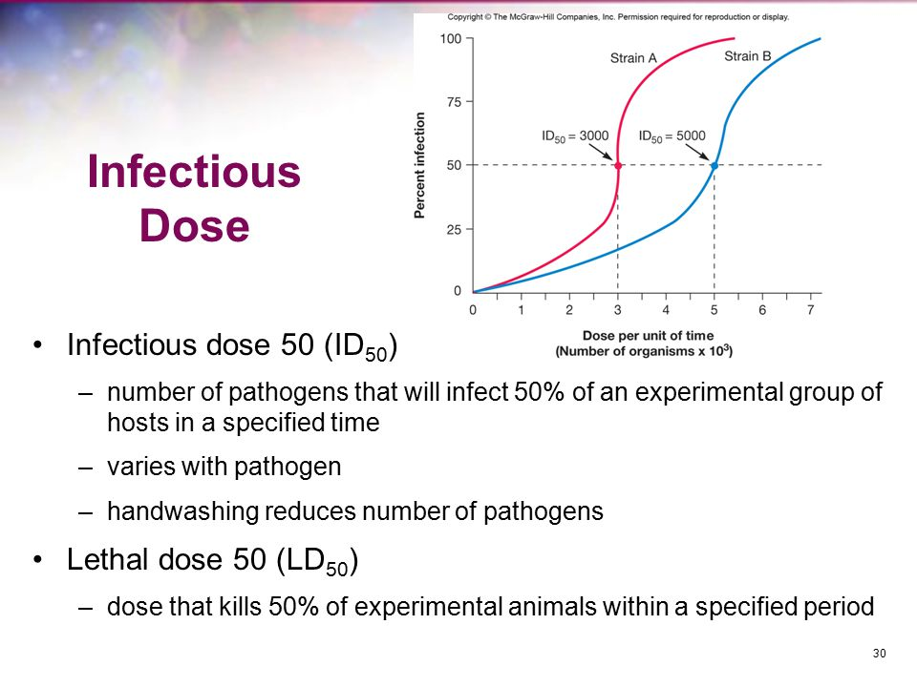
Pathogen

Slide 9
Many pathogens evolve rapidly in a changing environment
Antibiotics have been misused over time, and this has led to the evolution of bacteria and their resistance to antibiotics.
Infected people are treated with antibiotics
The antibiotics kill the bacteria in a majority of people and therefore cure them of the disease
This halts and stops the spread of the disease, killing the antibiotic sensitive strains of bacteria

Slide 10
Many pathogens evolve rapidly in a changing environment
Antibiotics have been misused over time, and this has led to the evolution of bacteria and their resistance to antibiotics.
High reproductive rate of pathogen/high mutation rate
Resistant bacteria survive and reproduce and pass their resistant gene on to offspring
Bacterium gains a gene that provides resistance against the antibiotic through mutation or conjugation
After many generations, a new population of resistant bacteria evolved.
Resistant bacteria live after antibiotic misused

Slide 11
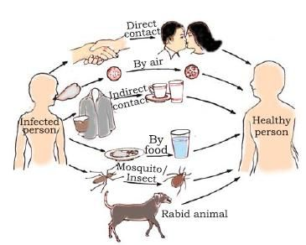
Pathogen
Mode of transmission
  Infectivity – the ability of a pathogen to spread from one host and infect another host.

Slide 12
Mode of transmission
How a pathogen is transmitted, its Mode of Transmission can influence its spread in a population, that is how quickly or slowly it will spread in a population.
Complete the table in your handout

Slide 14
Using bees as an example, explain the difference between direct and indirect transmission of disease. (4 marks)
Description | Marks
Direct transmission Result of touching/contact between two individuals For example, an infected Queen Bee/Nurse Bee touches the larvae and infects them | 1-2
Indirect transmission When there is an intermediary, either living or non-living. For example, contaminated food particles (e.g honey or pollen) lead to the infection of bees in another hive OR there is a vector OR there is contaminated equipment that allows the disease to be passed from one hive to another | 1-2
Total | 4

Slide 15
Factors Affecting the Spread of Disease
Environment
Globalisation
Urbanisation
Climate Change
Infrastructure

Slide 16
globalisation
Globalisation is the process by which the world is becoming increasingly interconnected as a result of increased trade (trade in live animals & plants), economic, and cultural exchange and travel

Slide 17
globalisation
The efficiency, speed and reach of modern transport puts people at risk from the emergence of new strains of familiar diseases, or from completely new diseases.
The global growth of economic activity, tourism and human migration is leading to ever more cases of the movement of both disease vectors and the diseases they carry.

Slide 18
Effect of globalisation example:
African swine fever (ASF) virus is endemic to sub-Saharan Africa.
It can spread directly through live or dead pigs and their body fluids.
It can also be spread indirectly through animal feed that contains pork infected with ASF, or via fomites such as transport storage surfaces, shoes and clothes.
The virus can survive in extreme, dry temperatures.

Slide 19
Effect of globalisation example:
The recent spread of ASF beyond Africa has been the biggest animal disease outbreak in history.
It has killed more than a quarter of the world’s pigs.
This has occurred due to the movement of pigs and pig products across borders.

Slide 20
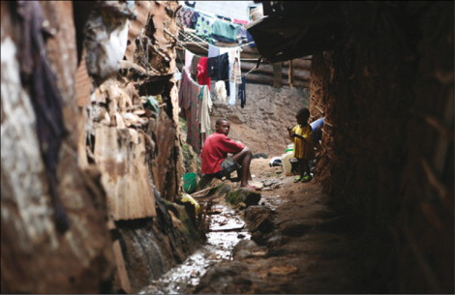
urbanisation
Majority of the worlds population live in urban areas
These urban areas very densely populated
The population may continue to grow due to job opportunities, or lack thereof in rural areas
In developing countries these people may be living in very unhygienic conditions making it difficult to control the spread of disease
https://www.thelancet.com/journals/laninf/article/PIIS1473-3099%2810%2970223-1/fulltext
Notes:
Dwellers of slums live in dire, overcrowded environments, with no access to water or sanitation. In the slum of Kibera, Kenya the number of inhabitants is almost 1 million.

Slide 21
Climate Change
Changes in rainfall patterns and amounts​
Temperature changes ​
Examples​
  Increase growth rate of pathogen ​
  Migratory animals move into new areas.​
  Spread of mosquitoes into new areas and at higher altitudes.​
  Contamination of water supplies during flooding.

Slide 22
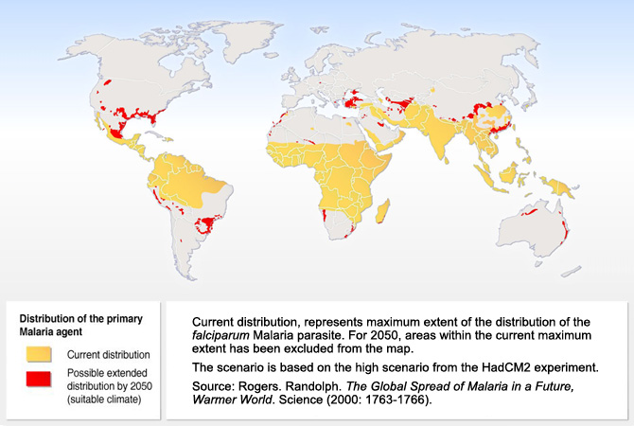
Notes:
The distribution of mosquito-borne diseases, such as malaria and Ross River disease/fever, are affected by global climatic changes.
Malaria is transferred by the pregnant female Anopheles mosquito vector.
Mosquitoes are more active and restricted to a warm environment and therefore are sensitive to climate change.
Global climate change will increase the average global air temperature, including higher at altitudes and result in changes in rainfall patterns.
Mosquitoes will spread to higher altitudes as they get warmer, because mosquitoes will breed in new areas if they are warm enough.

Slide 23
Host Factors
Susceptibility of hosts living in urban areas to epidemics and pandemics of infectious disease can be due to population density, variation in living conditions and healthcare provisions.
Population density
Variation in living conditions
Healthcare provisions
Susceptibility is due to

Slide 24
Population density
With a higher density of humans living together, this leads to a greater contact rate between infected and uninfected individuals, which leads to the opportunity for infections to spread faster.
A higher density means an increase in interactions between animals, humans, and ecosystems.
An outbreak in a rural setting may be controlled quickly and easily, compared with an outbreak in an urban setting, simply due to the absence of susceptible hosts, particularly if the mode of transmission is direct via contact or close contact.

Slide 25
Population density
Host susceptibility will also depend on:
Host behaviours
Host health and age.
Natural immunity
Herd immunity due to immunisation

Slide 26
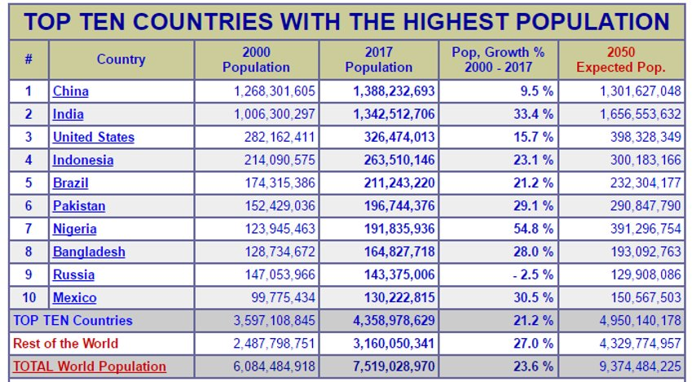
Population density

Slide 27
Variation in living conditions – Environmental
Infrastructure​
  Water supply – clean running water​
  Roads – transport of treatments​
  Sewerage systems – removal of waste​
  Housing – fly wires, clean environment​
  Pollution – removal of house hold waste.
  Electricity - If affordable and reliable, then many microbes could be killed using heat treatment but, in many cities, and especially for the homeless, electricity cannot be relied on.
Notes:
Poor living conditions can lead to the spread of infectious disease, especially airborne diseases such as TB, and vector-borne diseases such as malaria.
In developing countries, there is
less access to clean, treated water
Sanitation facilities are inadequate.
Consequently, urban slums usually have high levels of faecal matter in the water consumed by households. Waterborne diseases spread rapidly in such conditions.

Slide 28
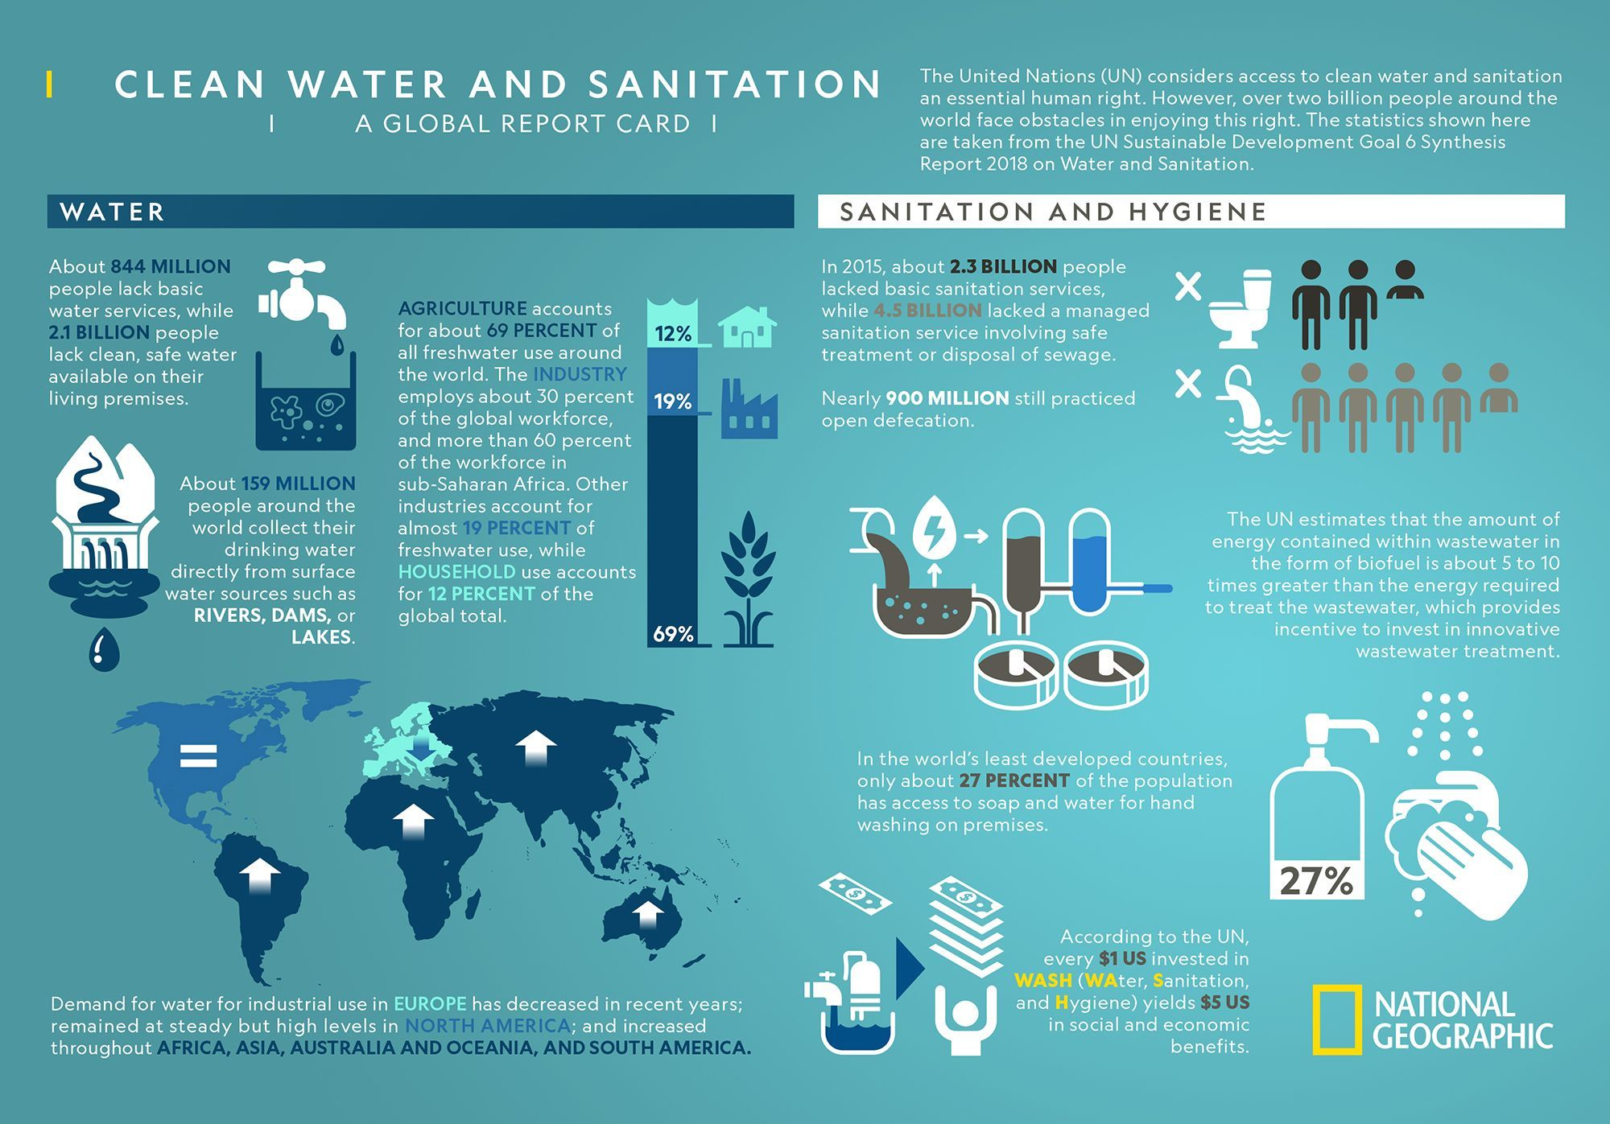
Variation in living conditions

Slide 29
Variation in living conditions - Nutrition
Inadequate nutrition leads to weaker immune systems, increasing susceptibility to many infectious diseases.
Diarrhoeal diseases are caused by the poor sanitation associated with poverty.

Slide 30
Healthcare provisions
Healthcare provisions include:
  medicine, vaccines, bandages and other medical supplies.
  Healthcare services and facilities such as hospitals and available health professionals are also considered to be provisions.

Slide 31
Healthcare provisions
Poor healthcare increases susceptibility to infectious disease.
Poor access to medications, particularly preventative medication such as vaccination, leaves many people vulnerable to infectious diseases.
Fewer individuals are able to be immunised against specific diseases.
Therefore, there is more risk of a disease spreading and a high proportion of susceptible individuals.

